Slide 1

JetSync Airline Reservation System
Group A 95

Slide 2
Introduction
In the fast-paced world of today, air travel has become a necessary part of modern mobility. The rising demand for air travel has made it necessary to create trustworthy and efficient systems to manage flight scheduling, ticketing, and other related processes. The aircraft ticket management system provides an automated platform that makes it simple for travellers and airlines to handle bookings, ticketing, and other related activities in order to achieve these goals. The majority of us connect with databases on a few occasions during the day. It's possible that during our operations—like booking a hotel or ticket—someone will gain access to a database. An overview of the airline ticket management system's reservation management process is given to you by this programme.

Slide 3
Purpose of the project
The goal of the aircraft Ticket Management System project is to provide a comprehensive software solution that addresses the problems and needs that airlines and passengers have while managing reservations and tickets for aircraft. These are the project's main goals
1. Streamlining the Booking Process.
2. Effective Ticket Management
3. Improving Customer Experience
4. Streamlining Operations for Airlines

Slide 4
Objectives
• To help the airline system become more operationally effective
• To partially automate the management of airline tickets. • An added attraction for potential customers. • It will additionally show the management's mindset that they are knowledgeable about the newest technology and ready to employ them. • Ensure that travellers have access to up-to-date information on flight availability, prices, and seat options so they can make informed decisions.

Slide 5
User requirement
Identification of Users (Stakeholders)
User Interviews/Observations and Surveys (Fact Gathering)
Use Case Analysis
Persona Development
Requirements Prioritization
Functional/Non-functional Requirements
Validation and Verification of the Findings

Slide 6
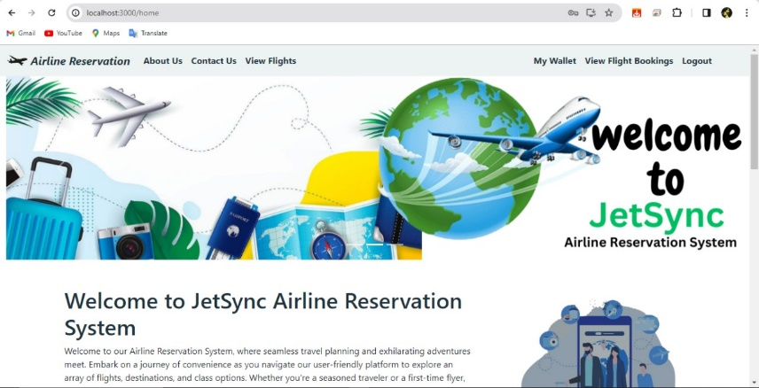
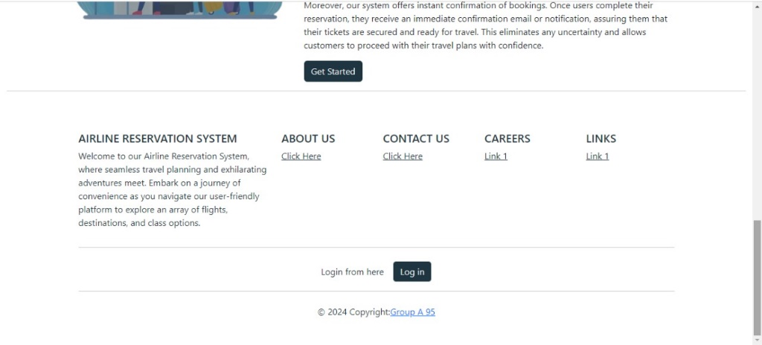
Home page

Slide 7
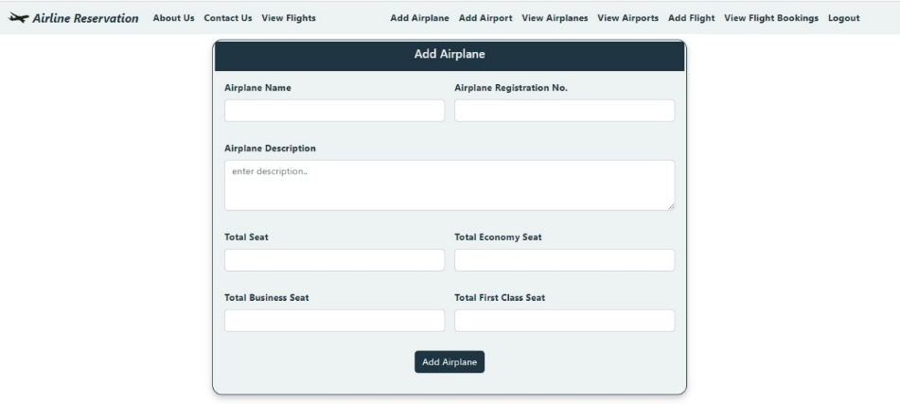
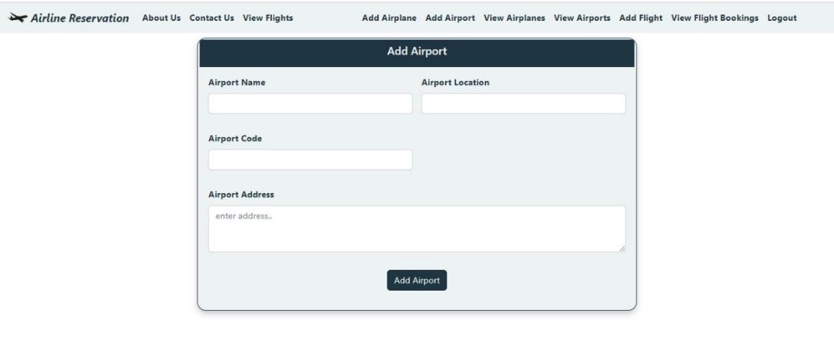
Admin page

Slide 8
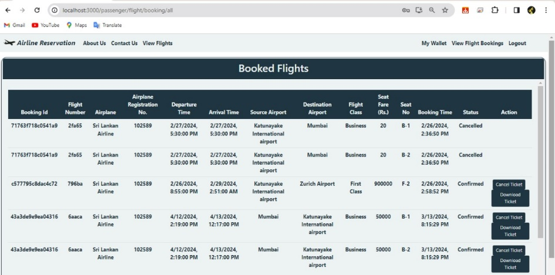
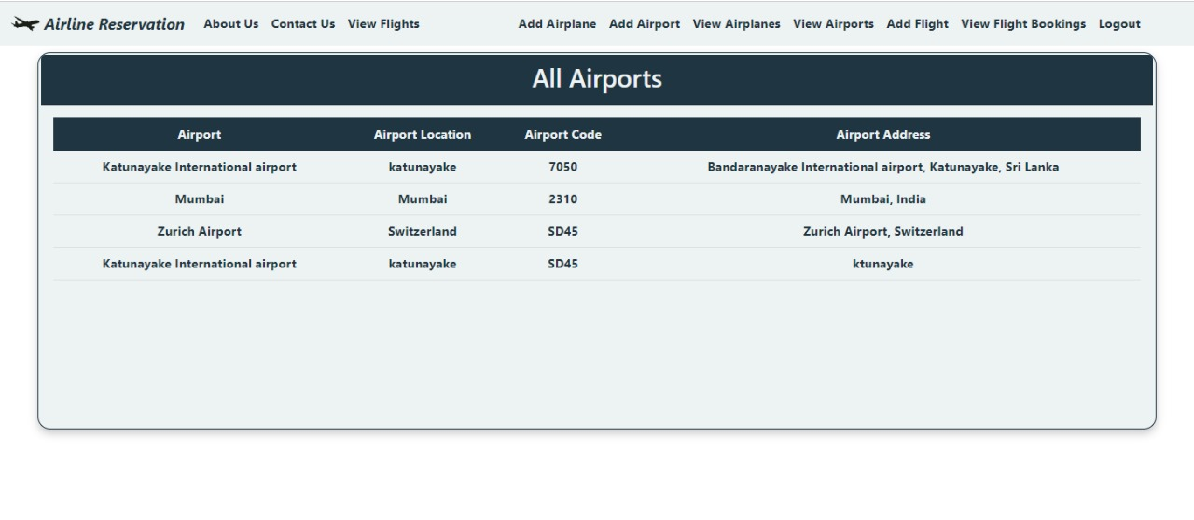
Admin page

Slide 9
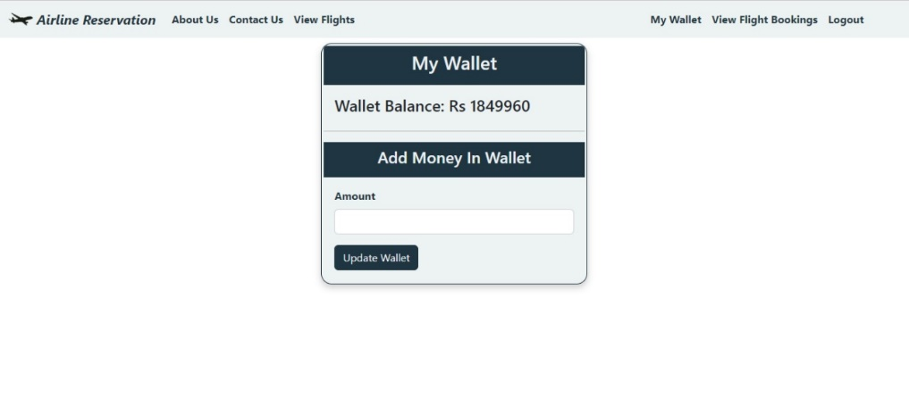
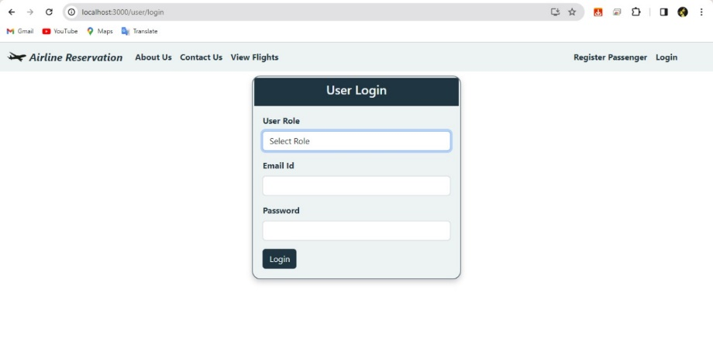
Passenger

Slide 10
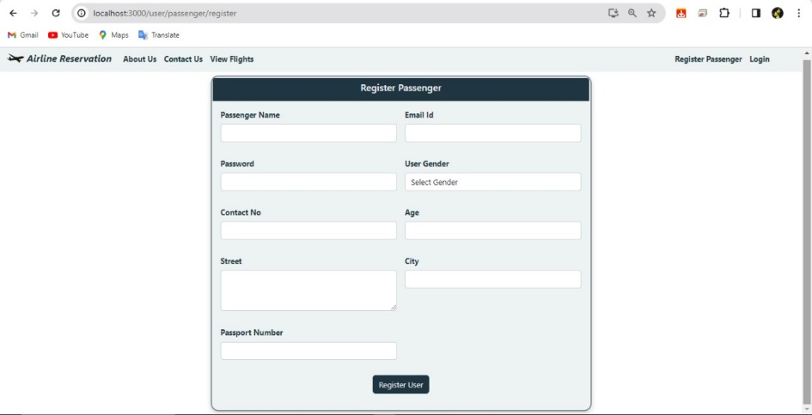
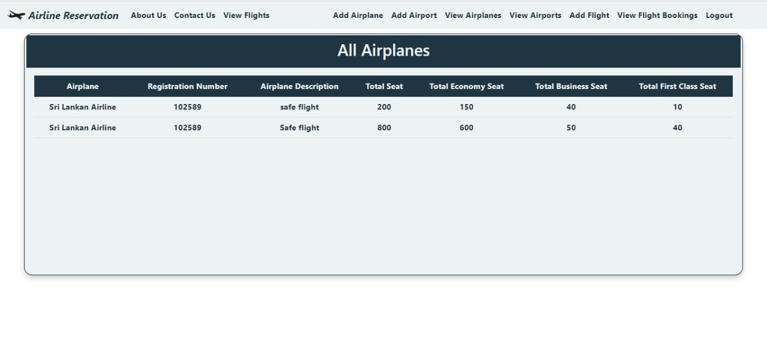
Passenger

Slide 11
Challenges faced
Integration challenges
Security concerns
Performance optimization
Error handling and debugging
Database connectivity issues
MySQL server stopping unexpectedly

Slide 12
References
Marichamy, L., n.d. Slide Share-SRS. [Online] Available at
https://www.slideshare.net/lavanyamarichamy/software-requirements-specification-108099965
target, T., n.d. Software requirement specification from internet.. [Online] Available at:
https://www.techtarget.com/searchsoftwarequality/definition/software-requirements-specification
Unknown, n.d. Software Requirement Specifications. [Online] Available at:
https://en.wikipedia.org/wiki/Software_requirements_specification

Slide 13
Conclusion
In summary, the creation of the airline reservation management system offers a comprehensive way for airline firms to improve user experience, expedite the booking process, and increase operational efficiency. Throughout the project, a number of important themes came to light, highlighting the significance of careful planning, stakeholder cooperation, and technological know-how.
User interviews, observations, and surveys were used to carefully collect requirements at the start of the project. These methods yielded insightful information on the needs and preferences of the users.
This stage was essential for establishing the system's goals and scope and making sure they matched the expectations of the stakeholders. Developing a scalable database schema, a solid backend architecture, and an easy-to-use user interface were the main goals of the design and development phases.

Slide 14
THANK YOU !

